Slide 1
Wild Plants Edibility Prediction Using IBM Watson Studio
PRESENTED BY:
TEAM NO: CSE-007
18UK1A0534 - Muppala Keerthana
18UK1A0556 - Bourishetty Swetha
18UK1A0538- Kaleru Naresh
18UK1A0507 – Bhukya Santhosh

Slide 2
OUTLINE
INTRODUCTION
OBJECTIVE
DATA
IMAGE PREPROCESSING
DEEP LEARNING ALGORITHM
MODEL BUILDING
SOFTWARE REQUIREMENTS
FUTURE SCOPE
CONCLUSION

Slide 3
INTRODUCTION
The rural communities of developing countries depend on wild edible plants to meet their food requirements during periods of food shortage. Wild edible plants are mostly serving as supplementary foods in different parts of the world because they are nutritionally rich and can supplement especially vitamins and micronutrients. The main objective of this project is to build Convolutional neural networks are a deep model to detect and classify the edibility of the wild plant. The model also suggests the effects of non-edible wild plant produce.
We are creating a web application where the user selects the image which is to be classified. The image is fed into the model that is trained and the predicted class will be displayed on the webpage.

Slide 4
OBJECTIVE
know fundamental concepts and techniques of the Artificial Neural Network and Convolution Neural Networks
Gain a broad understanding of image data.
Work with Sequential type of modeling
Work with Keras capabilities
Work with image processing techniques
know how to build a web application using the Flask framework.

Slide 5
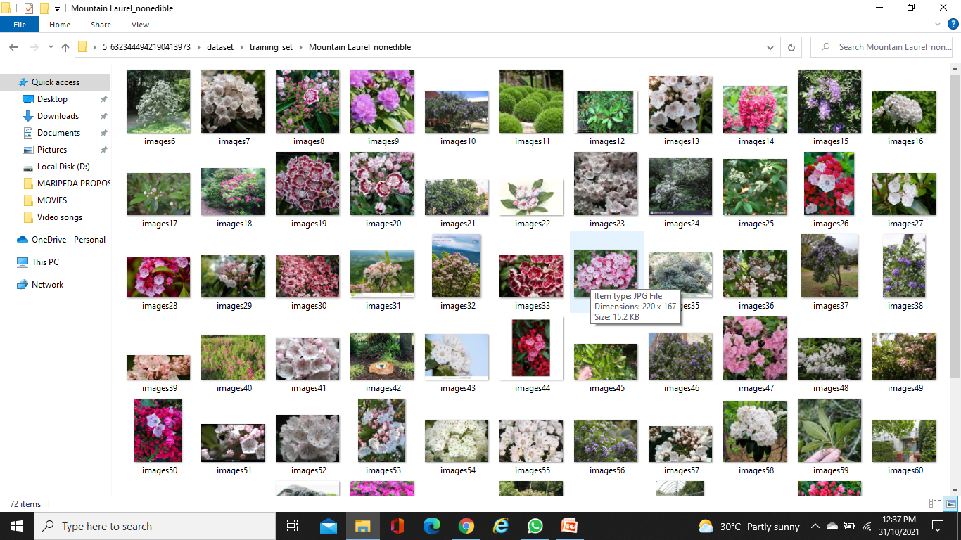
DATA
Wild Plants Edibility Prediction consists of:
The dataset contains six classes:
Asparagus_edible,
Blue Vervain_edible,
Cattail_edible'
Chicory_edible_non edible,
Fireweed_edible_non edible,
Green castor bean_non edible.

Slide 6
IMAGE PREPROCESSING:
Image Pre-processing includes the following main tasks:
Import ImageDataGenerator Library.
Configure ImageDataGenerator Class.
Applying ImageDataGenerator functionality to the trainset and test set.

Slide 7
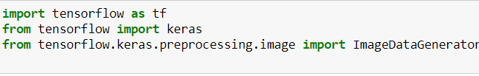
Import The ImageDataGenerator Library:
Image data augmentation is a technique that can be used to artificially expand the size of a training dataset by creating
modified versions of images in the dataset.
The Keras deep learning neural network library provides the capability to fit models using image data augmentation via the ImageDataGenerator class.
Let us import the ImageDataGenerator class from Keras

Slide 8
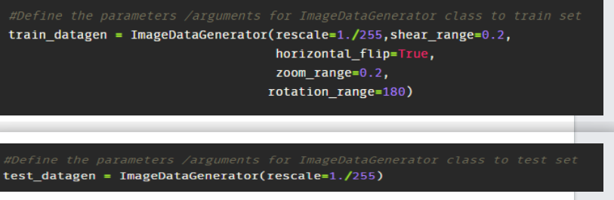
Configure ImageDataGenerator class:
There are five main types of data augmentation techniques for image data; specifically:
Image shifts via the width_shift_range and height_shift_range arguments.
Image flips via the horizontal_flip and vertical_flip arguments.
Image rotations via the rotation_range argument
Image brightness via the brightness_range argument.
Images zoom via the zoom_range argument.
An instance of the ImageDataGenerator class can be constructed for train and test.

Slide 9
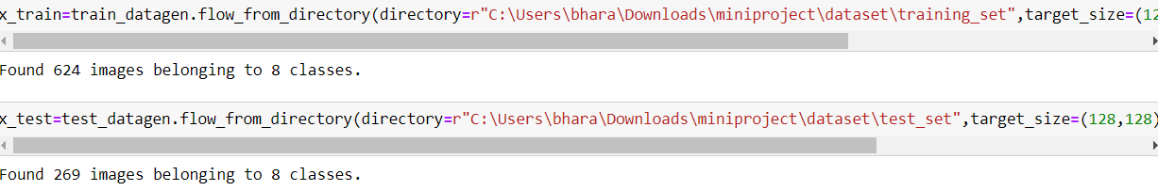
Apply ImageDataGenerator Functionality to Trainset and Testset:
Let us apply ImageDataGenerator functionality to Trainset and Testset by using the following code
For Training set using flow_from_directory function.

Slide 10
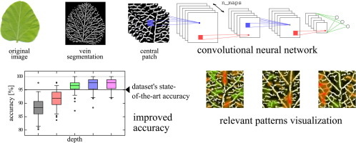
DEEP LEARNING ALGORITHM
Convolutional Neural Networks
The CNNs can be considered as one of the most efficiently flexible models for specializing in image as well as non-image data
It is made up of a single input layer, which generally is a two-dimensional arrangement of neurons for analyzing primary image data, which is similar to that of photo pixels.

Slide 11
MODEL BUILDING
Start building Machine Learning Model we are using Deep neural networks for building the model
This activity includes the following steps
Import the model building Libraries
Initializing the model
Adding CNN Layers
Adding Hidden Layer
Adding Output Layer
Configure the Learning Process
Training and testing the model
Saving the model

Slide 12
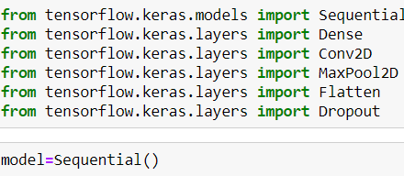
Import Libraries and initialize the model:
Keras has 2 ways to define a neural network:
Sequential
Function API

Slide 13
Adding of CNN Layers:
Convolution layer
Pooling layer
Flattening layer
Full Connection
Adding convolution layer:
In the convolution2D function we given arguments like, 64,(3,3), that means we are applying 64 filters of 3x3 matrix filter, and input_shape is the input image shape with rgb, here 128x128 is the size and 3 represent the channel, rgb color images.
And Activation function defines the output of input or set of inputs or in other terms defines node of the output of node that is given in inputs. They basically decide to deactivate neurons or activate them to get the desired output.
Adding Max Pooling Layer
Pooling reduces the dimensionality of images by reducing the number of pixels in the output from the previous convolutional layer. It keeps only the necessary details. Pooling is a technique in CNN which helps us to avoid over fitting of data, spatial invariance and distortion. After applying max pooling we will get another feature map called Pooled Feature Map.
Now will apply pooling technique.
Adding Flatten Layers
Now the pooled feature map from the pooling layer will be converted into a one single dimension matrix or map, where each pixel in one single column, nothing but flattening. Flattening layer converts multi dimension matrix to one single dimension layer.

Slide 14
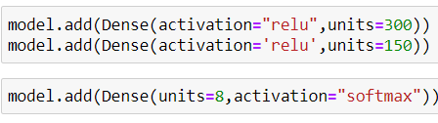
Adding of Dense Layers:
The name suggests that layers are fully connected (dense) by the neurons in a network layer. Each neuron in a layer receives an input from all the neurons present in the previous layer. Dense is used to add the layers.
Adding of Hidden Layers:
This step is to add a dense layer (hidden layer). We flatten the feature map and convert it into a vector or single dimensional array in the Flatten layer. This vector array is feed it as an input to the neural network and applies an activation function, such as sigmoid or other, and returns the output.

Slide 15
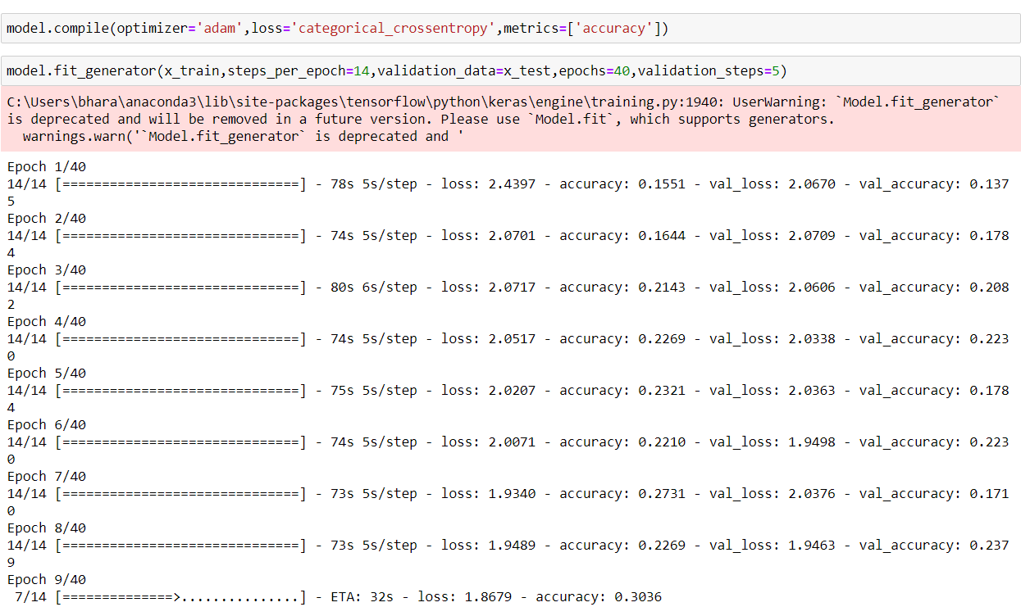
Configuring The Learning Process:
The compilation is the final step in creating a model. Once the compilation is done, we can move on to training phase. Loss function is used to find error or deviation in the learning process. Keras requires loss function during model compilation process.
Optimization is an important process which optimize the input weights by comparing the prediction and the loss function. Here we are using adam optimizer
Metrics is used to evaluate the performance of your model. It is similar to loss function, but not used in training process

Slide 16
SOFTWARE REQUIREMENTS
Anaconda navigator
Jupyter notebook
Jupiter spyder
Deep learning Tools: pandas,
NumPy,
Tensor flow,
Keras,

Slide 17
Future scope:
Wild plants are serving as supplementary foods for various rural communities.
The model built with convolution neural networks detect and classifying edibility of wild plants.
Our model also suggests the effects of non-edible wild plant procedure.

Slide 18
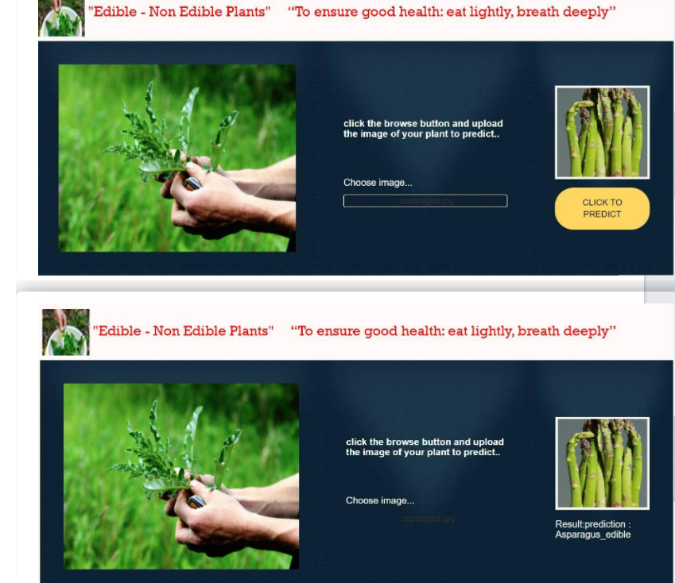
CONCLUSION:
In this project we have presented the Wild Plants Edibility Prediction
We have done the Prediction using Deep Learning Techniques.

